Slide 1
Apache Cassandra
Vijay Dialani
Associate Professor,
Department of Computer Science
Boise State University

Slide 2
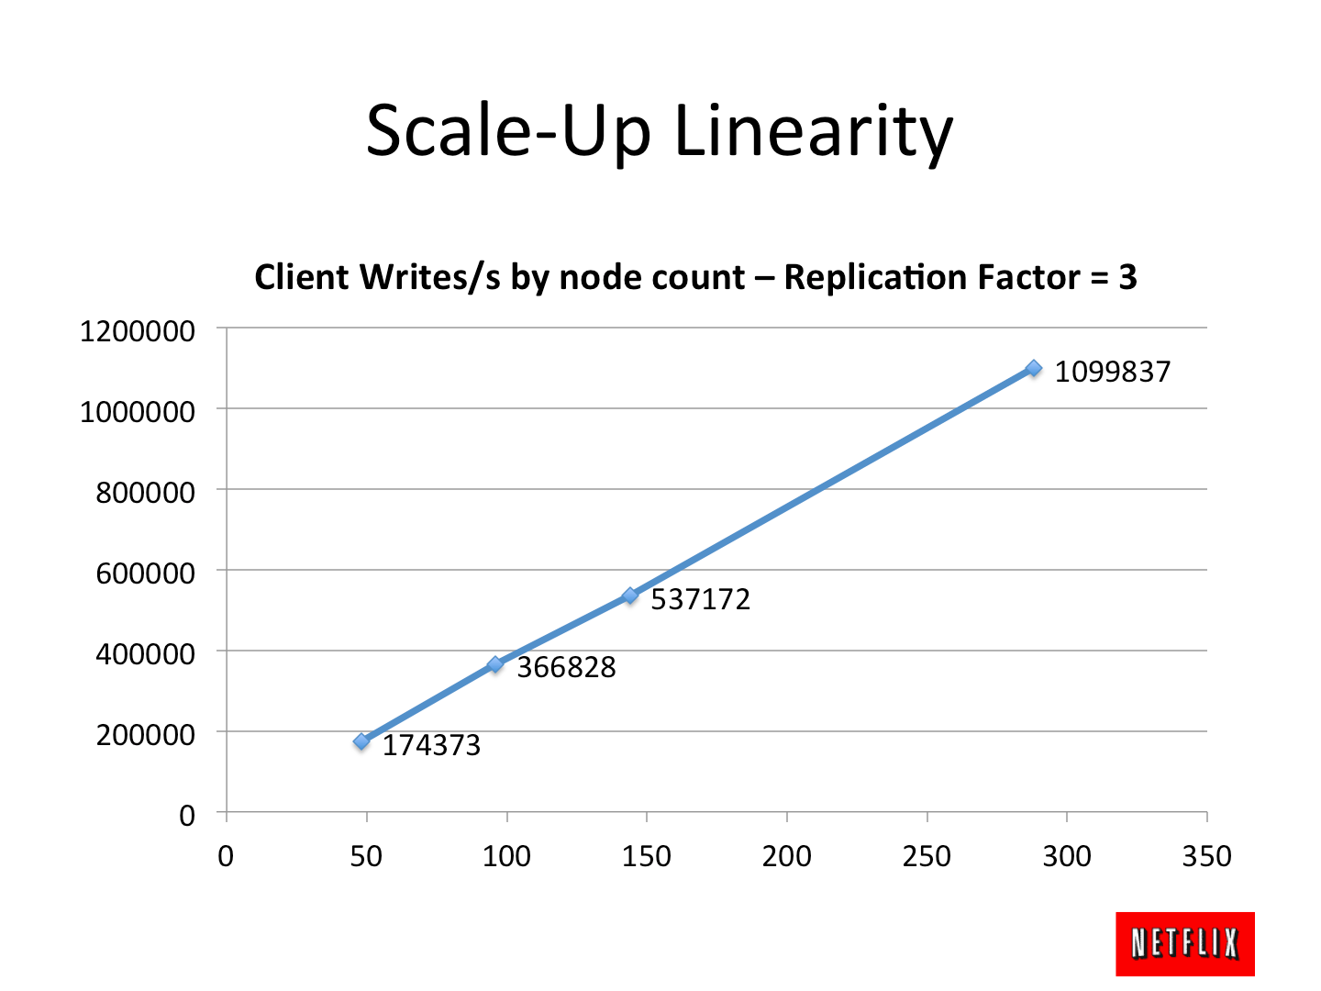
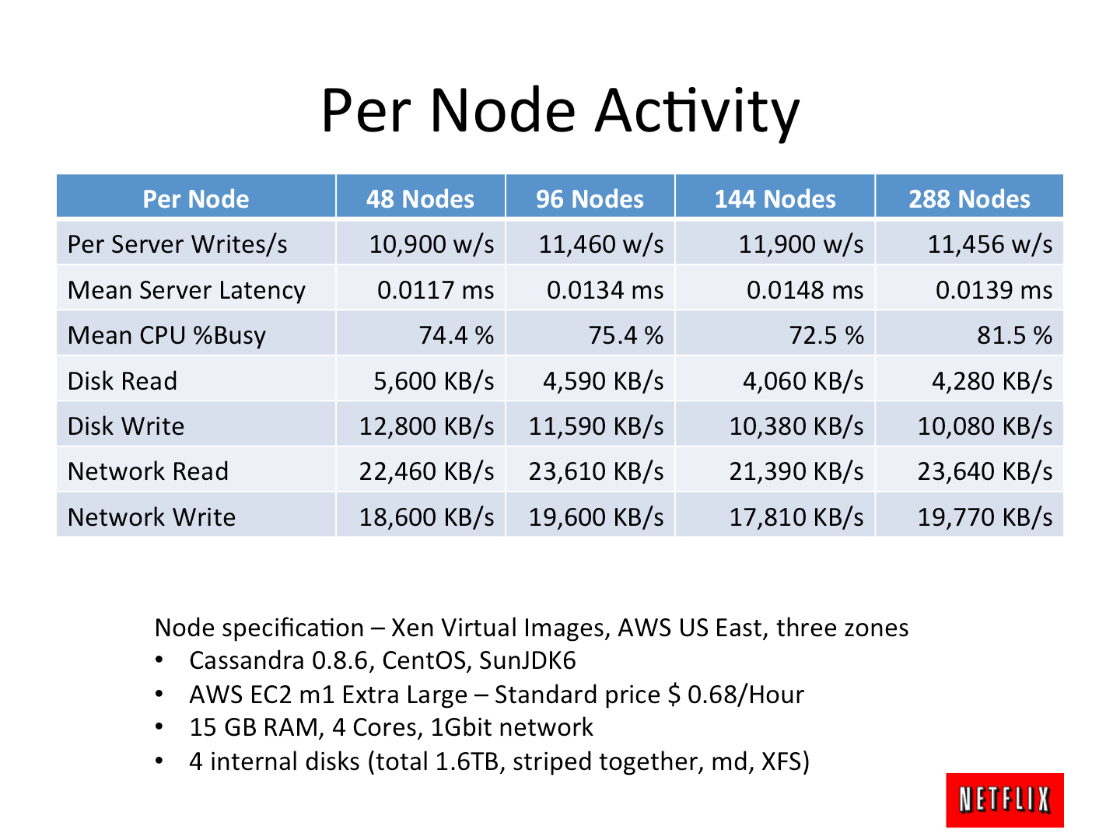
APACHE CASSANDRA
About Apache Cassandra
Linear scalability
Fault-tolerance on commodity hardware or cloud infrastructure
Support for replication across multiple datacenters is best-in-class
Provides lower latency for users
Can survive regional outages.
Scalable Write Performance
Workload Distribution

Slide 3
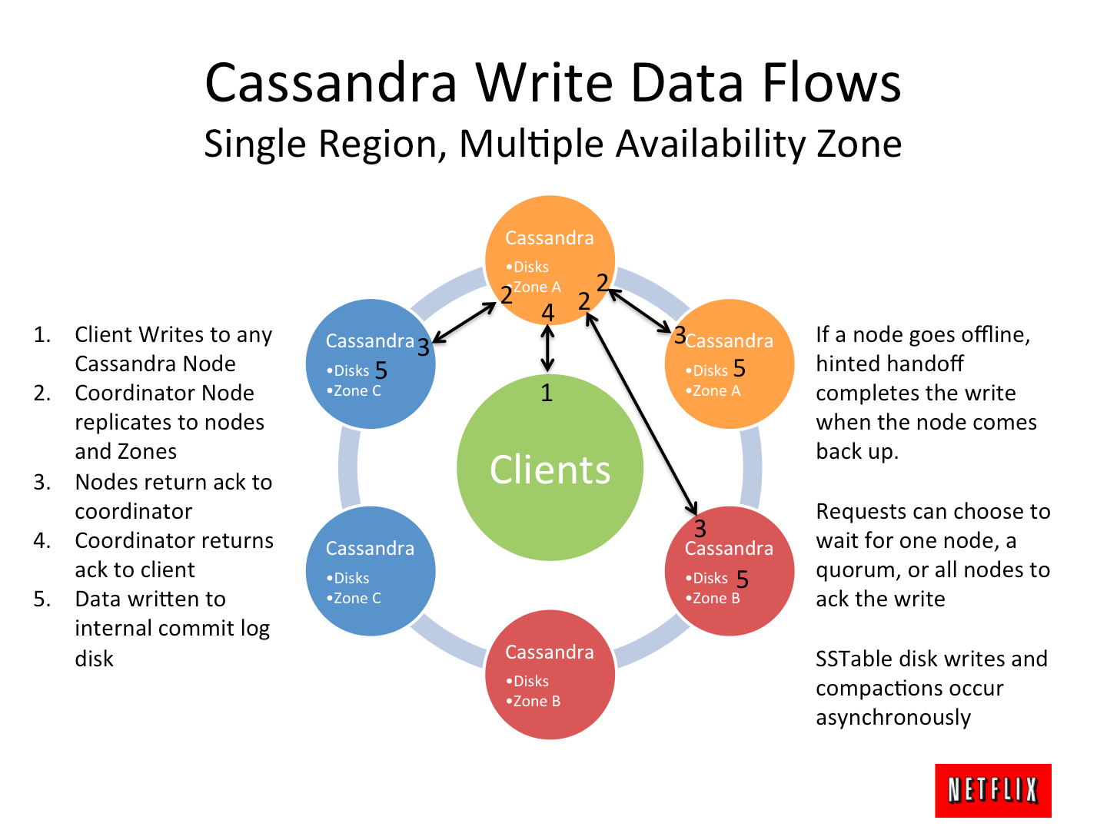
APACHE CASSANDRA
NETFLIX setup of Apache Cassandra

Slide 4
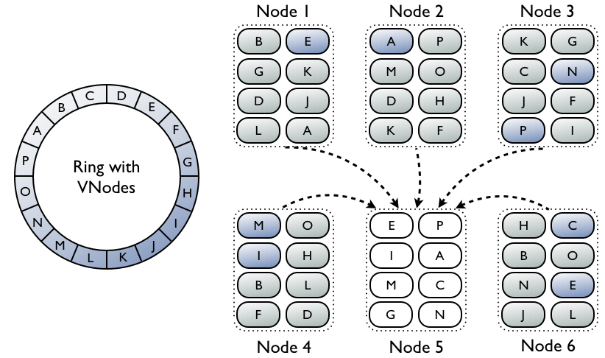
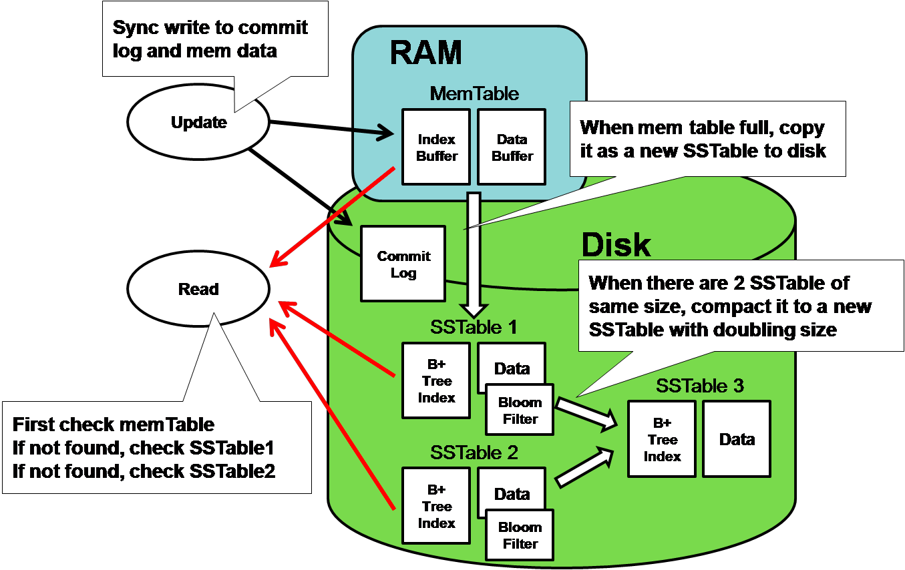
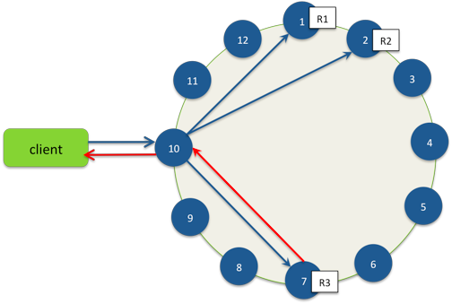
Cassandra V-Node Architecture
APACHE CASSANDRA
Single Node Architecture
Topology aware Client

Slide 5
Apache Cassandra
Cassandra Cluster (nodes configuration - cassandra-topology.properties)
# Cassandra Node IP=Data Center:Rack
192.168.1.100=DC1:RAC1
192.168.2.200=DC2:RAC2
10.0.0.10=DC1:RAC1
10.0.0.11=DC1:RAC1
10.0.0.12=DC1:RAC2
Configuring Cluster Properties – cassandra-rackdc.properties
# These properties are used with GossipingPropertyFileSnitch and will
# indicate the rack and dc for this node
dc=DC1
rack=RAC1
# Add a suffix to a datacenter name. Used by the Ec2Snitch and Ec2MultiRegionSnitch
# to append a string to the EC2 region name.
#dc_suffix=
# Uncomment the following line to make this snitch prefer the internal ip when possible, as the Ec2MultiRegionSnitch does.
# prefer_local=true

Slide 6
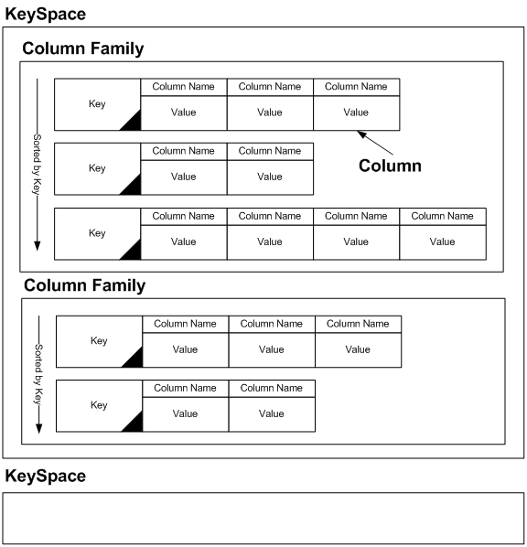
Apache Cassandra
Cassandra Architecture
KEYSPACES and Column Families
Topology aware- Client
Cluster Aware Layer (Node-1)
Cluster un-aware Layer
Cluster Aware Layer (Node-2)
Local In-Memory Processor
Disk
Cluster un-aware Layer
Local In-Memory Processor
Disk

Slide 7
Apache Cassandra
Cassandra Query Language
Subset of SQL
Allows create, alter, drop and rename – Keyspaces, Column Families, Columns
Supports select, insert, update, delete on Rows/RowCollections
Extends SQL to include replication specific constructs
Does not support Joins
Example - Key Space and Column Family creation
CREATE KEYSPACE Excalibur WITH replication =
{'class': 'NetworkTopologyStrategy', 'DC1' : 1, 'DC2' : 3}
AND durable_writes = false;
USE KEYSPACE Excalibur;
CREATE TABLE monkeySpecies ( species text PRIMARY KEY, common_name text, population varint, average_size int ) WITH comment='Important biological records' AND read_repair_chance = 1.0;
*Note that the CREATE COLUMNFAMILY syntax is supported as an alias for CREATE TABLE*

Slide 8
Questions and Answers

